Slide 1
Interactive Corporate Interface for Business
a

Slide 2
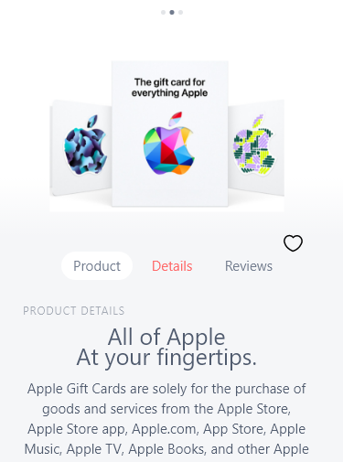

Welcome to our very first PROJECT Presentation about Ecommerce Software (Gift Shop)
Course Title: Integrated Design Project- I, Course Code: CSE-324
Section: 212-D1.
a

Slide 3



PRESENTED BY
I’m Sakib Akhter 212002083 Department of CSE
Green University Bangladesh
I’m Farzana Yeasmin 212002009 Department of CSE
Green University Bangladesh
I’m Tarikul Islam 212002008 Department of CSE
Green University Bangladesh
a

Slide 4

Course Instructor
MR. PALASH ROY
Lecturer Department of CSE
Green University Bangladesh
a

Slide 5

Introduction
Overview
The project is an advanced eCommerce software
solution tailored specifically for gift shops.
Importance in the Digital Age
Purpose
- Comprehensive Platform
- Efficient Operations
a
Notes:
Overview: The project is an advanced eCommerce software solution tailored specifically for gift shops. It aims to address the unique needs of gift shop owners by providing an all-in-one platform that streamlines the process of setting up and managing an online store. In the digital age, a strong online presence is essential for businesses to reach a broader audience and remain competitive. This software integrates various features such as product management, secure payment processing, and customer relationship tools to enhance the overall efficiency and effectiveness of online gift shops.
Importance in the Digital Age: In today's digital age, having an online presence is crucial for businesses. The eCommerce platform provides gift shops with the tools needed to reach a wider audience, enhance customer experience, and streamline operations.
Purpose: To provide a comprehensive platform for gift shops to operate online efficiently, ensuring a seamless and user-friendly experience for both shop owners and customers. The software is designed to simplify the complexities of eCommerce, from managing inventory and processing orders to engaging with customers and analyzing sales data. By leveraging this platform, gift shop owners can focus on growing their business and enhancing customer satisfaction while the software handles the technical and operational aspects of running an online store.
Comprehensive Platform: The software offers a robust and comprehensive platform that includes features such as inventory management, secure payment processing, customer management, and analytics.
Efficient Operations: It aims to simplify the online business setup and operational processes for gift shops, making it easier for owners to manage their stores, track orders, and provide excellent customer service.

Slide 6
Features
User-Friendly Interface
Product Management
Security Features
a92737
Order Management
Customer Management
Customization
a

Slide 7
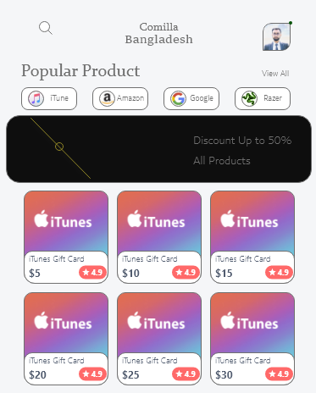
Demonstration
So without waiting any longer lets detailly understand the project
a

Slide 8
Future scope and limitations
Future
Web App Development
Multi-language and Multi-currency Support
AI Customer Support
Social Media Integration
limitations
Technical Complexity
Data Privacy and Security Concerns
User Adoption and Learning Curve
Scalability Issues
a
Notes:
Mobile App Development
Description: Develop dedicated mobile applications for iOS and Android to improve accessibility and provide a seamless shopping experience on mobile devices.
Benefits: Increased user engagement, higher mobile traffic, and improved customer convenience.
Multi-language and Multi-currency Support
Description: Expand the software to support multiple languages and currencies to cater to a global customer base.
Benefits: Increased market reach, improved user experience for international customers, and higher sales potential.
AI Customer Support
Description: Integrate AI-driven chatbots for handling common customer inquiries and providing 24/7 support.
Benefits: Reduced response times, improved customer service efficiency, and lower operational costs.
Social Media Integration
Description: Develop features that enable seamless integration with social media platforms for marketing and social commerce.
Benefits: Increased brand visibility, enhanced social engagement, and additional sales channels.
……………………………………………………………..
Technical Complexity
Description: Complexity in implementing and maintaining advanced features such as AI, AR, and multi-language support.
Impact: Need for skilled technical personnel, potential technical issues, and higher maintenance costs.
Data Privacy and Security Concerns
Description: Ensuring robust data protection measures to safeguard customer information.
Impact: Increased regulatory compliance requirements, potential risks of data breaches.
User Adoption and Learning Curve
Description: Users may face a learning curve in adapting to new features and technologies.
Impact: Potential initial resistance from users, need for comprehensive user training and support.
Scalability Issues
Description: Ensuring the platform can scale effectively to handle increased traffic and transaction volumes.
Impact: Potential performance issues, need for robust infrastructure and optimization strategies.

Slide 9
Impacts on Societal
In of gift shop owners.
a
Notes:
The eCommerce software project for gift shops aims to provide a user-friendly platform for efficient online presence. It includes features like product management, secure payment gateways, and advanced analytics. The project addresses challenges like limited audience reach and inventory management. Future enhancements include mobile app development, AI-driven insights, AR integration, and global support.

Slide 10
Conclusion
a
Notes:
Our eCommerce software for gift shops represents a significant leap forward in empowering small business owners for the digital era. With a user-friendly interface, robust product management, secure payment gateways, detailed analytics, and customer relationship tools, it ensures an optimized online shopping experience. Future enhancements like mobile app development, AI-driven analytics, and global support will further strengthen its market position, enabling gift shop owners to stay ahead of industry trends. In summary, this project facilitates the transition of gift shops to the online marketplace, fostering sustainable growth and success while allowing owners to focus on curating unique products.

Slide 11
Thanks!
Does anyone have any questions?
a

